Slide 1


Loan Default Prediction using Machine Learning
Data Science and AI ML
Team Members:
1. Hemanth
2. Rakshith B
3. Ruchitha K M
4. Sumaiya N
5. Vandana J
Guide: Kavya Rao

Slide 2
Agenda:
Introduction
SMART Objectives
5W1H Analysis and SCAMPER Ideation
Literature Insights
Proposed Solution
System Overview
Gantt Chart
Expected Outcome

Slide 3
Problem Statement
Financial institutions face difficulty in accurately identifying borrowers who may default on loan. Traditional credit scoring methods rely on limited financial information and may not provide high prediction accuracy. Hence, there is a need for a data-driven machine learning system that can analyze borrower data and predict loan default risk more effectively.
Motivation / Why this problem matters:
Reduce bad loans and repayment failures
Improve speed of loan approval decisions
Support data-backed lending
Minimize human bias in risk analysis

Slide 4
Introduction
Loan default prediction is an important task for financial institutions to identify borrowers who may fail to repay loan.
Traditional credit scoring methods rely on limited borrower financial history.
These methods may not accurately capture real repayment risk.
Machine learning helps analyze large borrower datasets efficiently.
It improves decision-making by predicting potential defaults early.
This helps banks reduce losses and improve lending quality.
Problem Area:
Who Faces This Problem? - Banks, NBFCs, microfinance institutions.
Where Does It Occur? - Loan approval and risk assessment departments.
Why Is It Important? - Prevents bad loans and reduces financial losses.

Slide 5
Objectives (SMART)
Specific: Build a machine learning model to classify borrowers into default / non-default categories.
Measurable: Achieve high prediction accuracy above baseline traditional scoring methods.
Achievable: Use borrower dataset with preprocessing, feature engineering, and ML algorithms.
Relevant: Supports banks in credit risk assessment and safer lending.
Time Bound: Complete model building, testing, and deployment prototype within project timeline.

Slide 6
5W1H Analysis
Factor | Content
WHO | Banks, financial institutions, loan officers
WHY | To identify risky borrowers before loan approval
HOW | By analyzing borrower data using ML models
WHAT | Loan default prediction system
WHERE | Loan processing and risk management systems
WHEN | During pre-loan approval and periodic risk review

Slide 7
Literature Insights
Title | Author | Description | Pros | Cons
A Machine Learning Approach for Loan Default Prediction [1]. | H. Abedin, M. Rahman, & S. Hossain. (2025) | This study applies machine learning techniques to analyze borrower financial data and predict loan default risk to support better credit decision-making. | This paper improves loan default prediction using machine learning, offering higher accuracy and better risk assessment compared to traditional methods. It also supports data-driven decision-making for financial institutions. | However, the models may suffer from data imbalance and lack interpretability, making them harder to apply in real-world banking systems. Additionally, performance depends heavily on data quality and preprocessing.

Slide 8
Loan Default Prediction Using Machine Learning Algorithms. [2] | A.S. Reddy, K.V.N. Sunitha & P. Ramesh. (2025) | This paper analyzes different machine learning algorithms to predict loan defaults using borrower financial data and compares their performance to improve credit risk prediction. | This paper uses multiple machine learning algorithms to improve loan default prediction accuracy and compares their performance to select the best model | However, it may face issues like data imbalance and overfitting, and the models require proper preprocessing and tuning..
Explainable Prediction of Loan Default Based on Machine Learning Models. [3]. | Xu Zhu, Qingyong Chu, Xinchang Song, Ping Hu, and Lu Peng. (2023) | This paper uses machine learning models to predict loan default and applies explainable AI techniques to understand the important factors influencing the predictions. | Accurately predicts loan defaults using machine learning and improves transparency with explainable AI techniques. | Models can be complex to interpret and depend heavily on data quality and preprocessing.

Slide 9
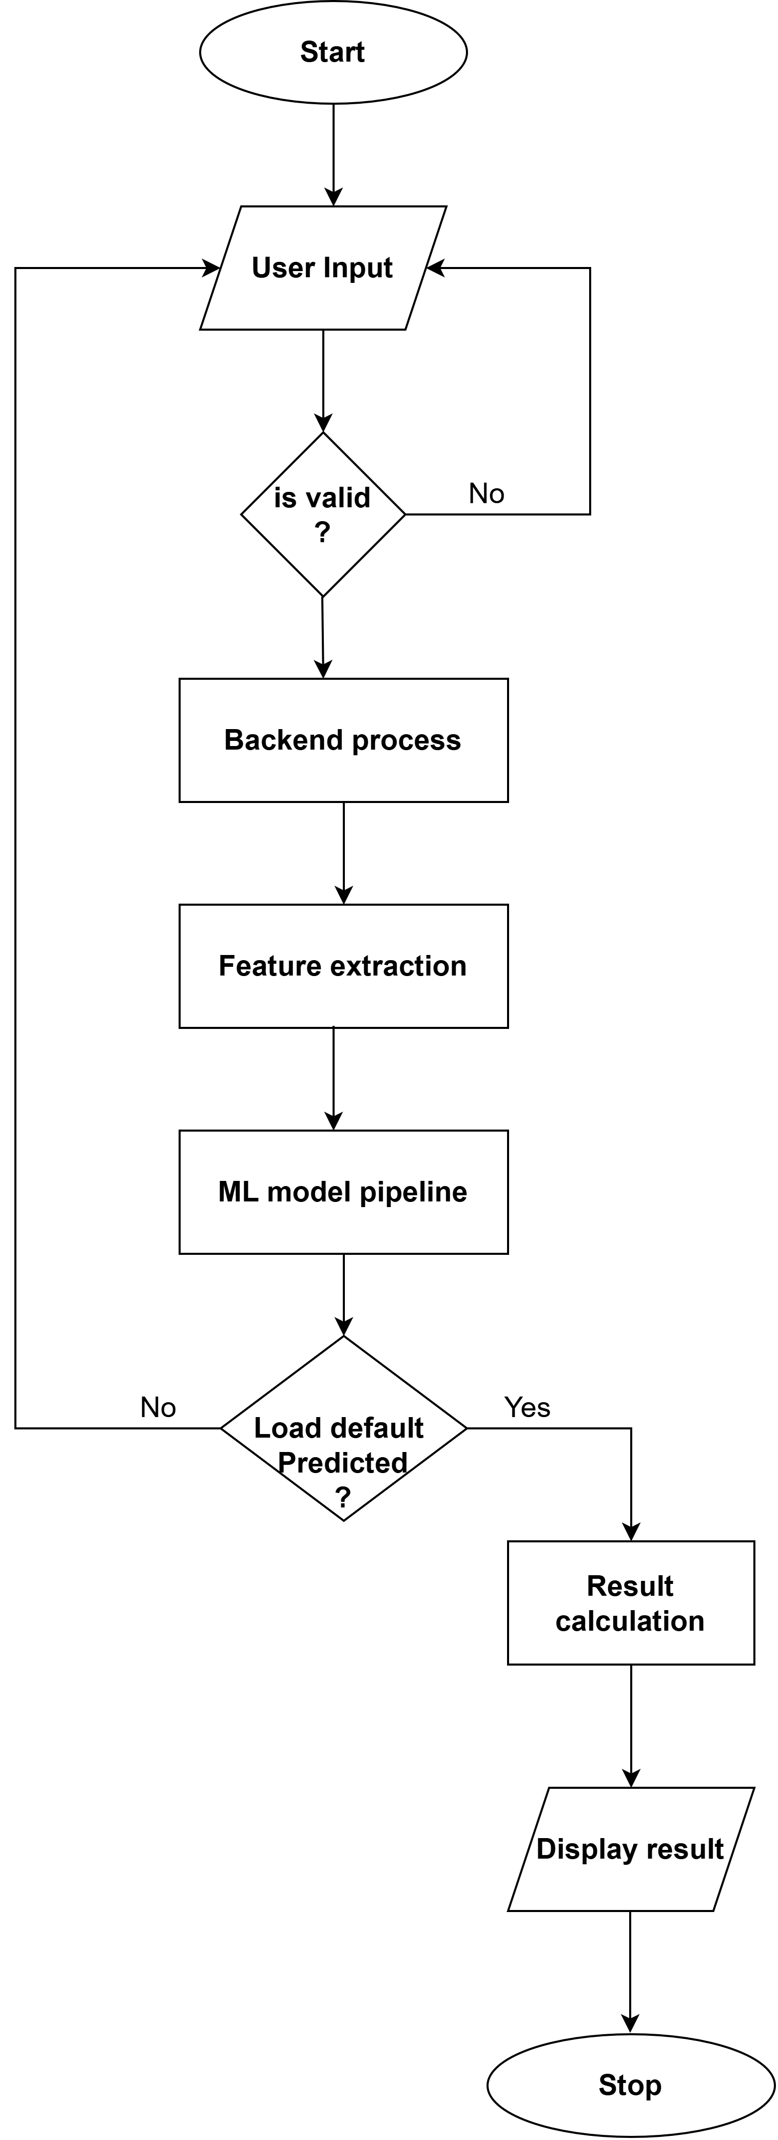
Proposed Solution

Slide 10
Programming Language:Python Frontend:HTML,CSS,Bootstrap Backend Framework:Flask Database:MySQL Development Tools:VS Code
Installation & System Overview (Basic Diagram)Configuration

Slide 11
Gantt Chart
Project Details | Week 1 | Week 2 | Week 3 | Week 4 | Week 5 | Week 6 | Week 7 | Week 8 | Week 9 | Week 10 | Week 11 | Week 12 | Week 13 | Week 14 | Week 15 | Week 16
Problem Analysis |  | ■ | ■
Literature Survey |  |  | ■ | ■
Requirement Anlaysis |  |  | ■ | ■ | ■
System Design |  |  |  | ■ | ■
Data Collection and Preparation |  |  |  |  | ■ | ■ | ■
ML model |  |  |  |  |  |  |  | ■ | ■ | ■ | ■
Backend setup |  |  |  |  |  |  |  |  |  | ■ | ■ | ■
Frontend Development |  |  |  |  |  |  |  |  |  |  | ■ | ■ | ■
System integration and testing |  |  |  |  |  |  |  |  |  |  |  | ■ | ■ | ■
Documentation and final presentation |  |  |  |  |  |  |  |  |  |  |  |  |  | ■ | ■
Report |  |  |  |  |  |  |  |  |  |  |  |  |  |  |  | ■

Slide 12
Develop a machine learning model that predicts whether a borrower will default or repay a loan. Identify important financial features that influence credit risk and loan repayment behavior. Improve the accuracy of credit risk prediction using machine learning algorithms. Help financial institutions make better and faster lending decisions.
Expected Outcome

